Slide 1
ELEMENTARY STATISTICS, BLUMAN
TI-84 Graphing Calculator Box Plots (Compare Distributions)
© 2019 McGraw-Hill Education. All rights reserved. Authorized only for instructor use in the classroom. No reproduction or further distribution permitted without the prior written consent of McGraw-Hill Education.

Slide 2
Objectives for this PowerPoint
Construct a Boxplot using the TI Graphing Calculator.

Slide 3
Previous PowerPoint
In a previous PowerPoint we learned how to find the Five Number Summary and how to construct a boxplot for data for test scores for a class of 30 students.

Slide 4
Data Set 1
21 | 53
21 | 53
24 | 54
24 | 57
32 | 58
34 | 59
35 | 60
36 | 61
38 | 64
42 | 64
44 | 65
45 | 84
46 | 89
47 | 92
51 | 98
Thirty students in a class took a test. The scores are shown to the right. The instructor wished to find the quartiles for this set of data.
Min = 21
Q₁ = 36
Q₂ = Median = 52
Q₃ = 61
Max = 98

Slide 5
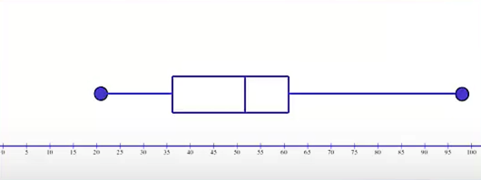
Boxplot for Data
We can use the TI graphing calculator to generate this boxplot.

Slide 6
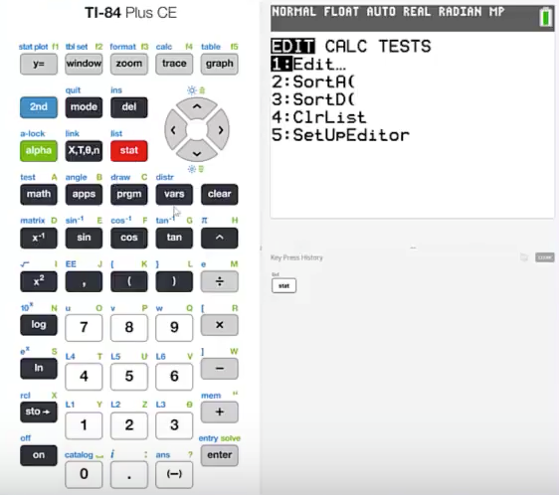
TI - Data Set 1 (1)
We should begin by pressing stat and then 1 to edit a list.

Slide 7
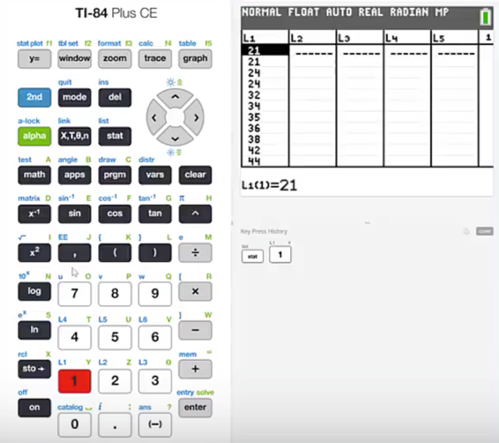
TI - Data Set 1 (2)
Enter the values into List 1.

Slide 8
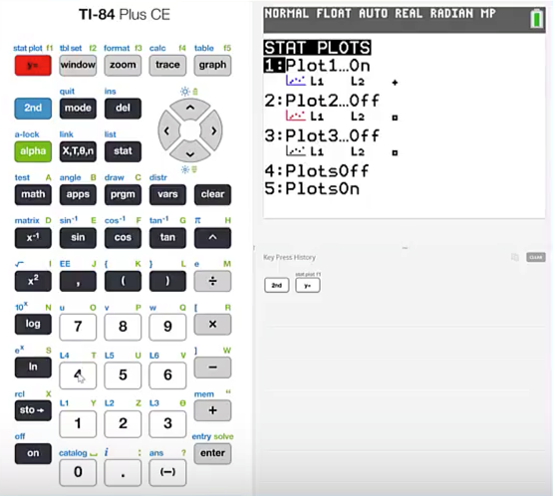
TI - Data Set 1 (3)
In order to graph a boxplot we'll begin by pressing 2nd stat plot.
Make sure that all of the plots are off.

Slide 9
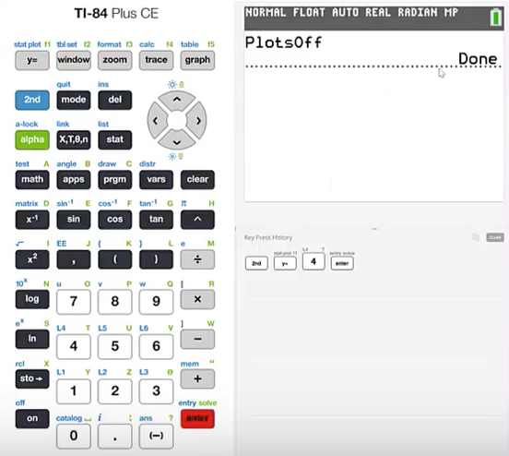
TI - Data Set 1 (4)
We can do that by pressing 4 and then enter.
We get a notation that the process is done.

Slide 10
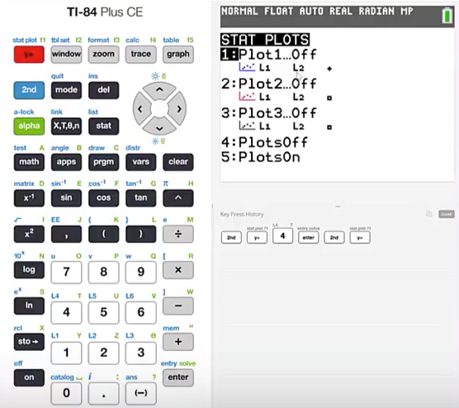
TI - Data Set 1 (5)
Now press 2nd stat plot
Now we see that all the plots are off.
We'll work with the first one.

Slide 11
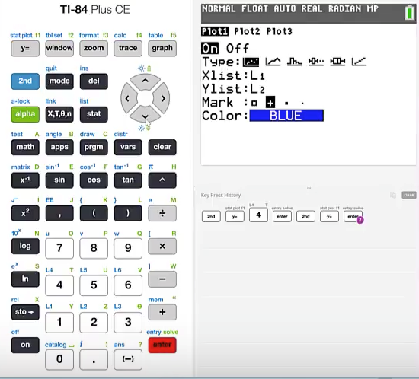
TI - Data Set 1 (6)
Press enter and then we’ll make sure that we turn this one on.

Slide 12
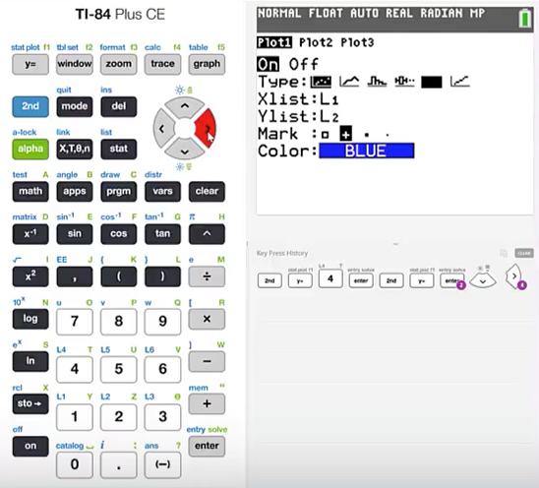
TI - Data Set 1 (7)
We need to select the correct type of graph which in this case will be a boxplot.
Cursor down to type and then cursor over to the icon that looks like a boxplot and press enter.

Slide 13
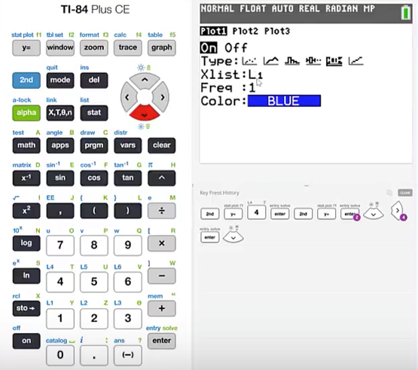
TI - Data Set 1 (8)
We will want to make sure that the correct list is specified. Our data are in List 1. Make sure that L1 is selected.

Slide 14
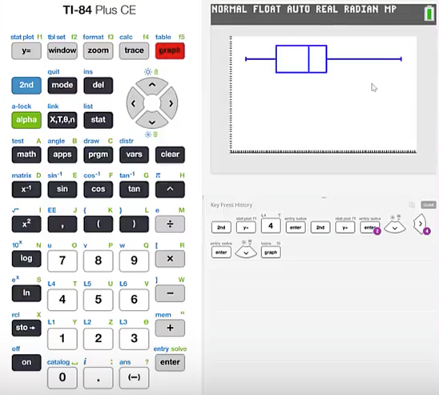
TI - Data Set 1 (9)
Press graph and our boxplot shows.
If the boxplot does not appear in the window it will be important to make sure that the window is set with the correct parameters so the entire boxplot is displayed.

Slide 15
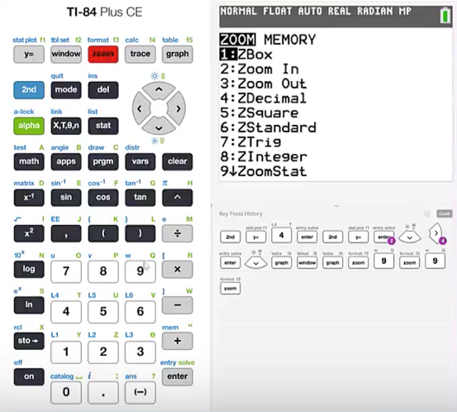
TI - Data Set 1 (10)
We will do that by pressing zoom and then 9 for ZoomStat.

Slide 16
Data Set 2 (1)
38 | 83
42 | 84
46 | 84
52 | 85
58 | 85
65 | 89
68 | 90
72 | 90
75 | 92
76 | 93
77 | 93
78 | 94
81 | 96
82 | 97
83 | 98
The instructor decided to allow the students to retake the test. The scores for the retake are shown to the right.
Min = 38
Q₁ = 72
Q₂ = Median = 83
Q₃ = 90
Max = 98

Slide 17
Data Set 2 (2)
This set of data also from our previous PowerPoint shows the scores for the retake of the same test.
We will use the TI graphing calculator to generate this boxplot.

Slide 18
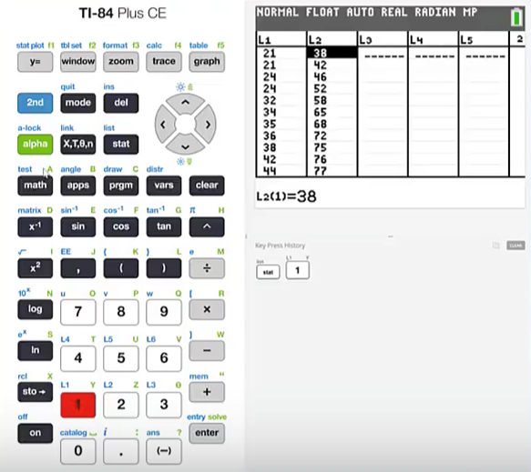
TI - Data Set 2 (1)
Press stat and 1 to Edit the list.
Enter the new data in List 2.

Slide 19
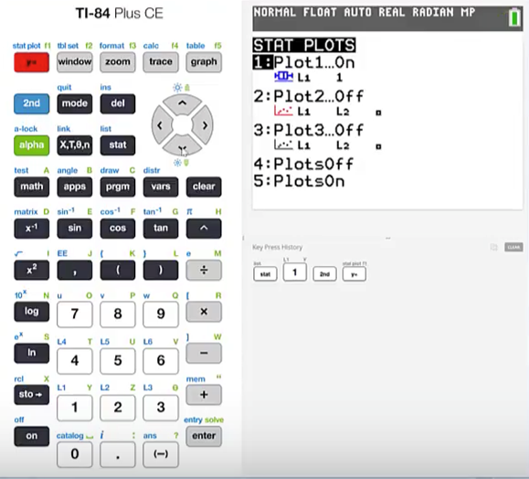
TI - Data Set 2 (2)
Press 2nd stat plot so that we can view the boxplots together.
Cursor down to Plot 2 and press enter.
Highlight the word On and press enter
Cursor down to the graph type and then cursor over to the boxplot icon and press enter.

Slide 20
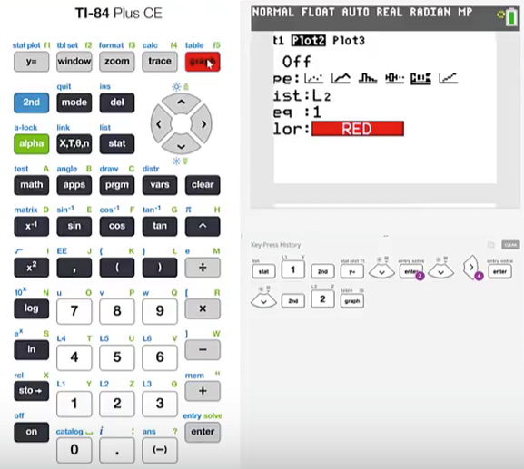
TI - Data Set 2 (3)
Cursor down to the graph type and then cursor over to the boxplot icon and press enter.
This second set of data is entered into List 2.
Cursor down to X List and then press 2nd L2 then press graph.

Slide 21
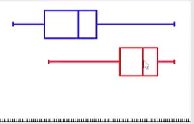
Compare the Two Boxplots
Now we can compare the distributions of data for the two different data sets. In the first data set the line to the right is longer which indicates a positively skewed set of data.
In the second set of data which represented the retake of the exam. We can see that the line to the left is longer. Which indicates a negatively skewed set of data.

Slide 22
Summary
In this PowerPoint we learned how to construct a boxplot using the TI Graphing Calculator.

